Slide 1
Elementary Edition

Slide 2
Book One
It’s a book about friendship and kindness
It highlights the struggles of one young boy
Auggie is a hero who was meant to stand out, in a very good way

Slide 3
Book Two
It teaches people to stand up for what they believe in
It’s about a girl raised in Pakistan, who now travels the world
She feels that every girl has the right to be educated

Slide 4
Book Three
The main character is a twelve year old boy
Other characters include Grover, Mr Brunner, and Mrs Dodds
The series is based on Greek mythology. This is the first book

Slide 5
Book Four
Sometimes we all trip and fall
Sometimes, it requires lots of dental work!
The book also contains an earthquake, and friends who may not really be friends.

Slide 6
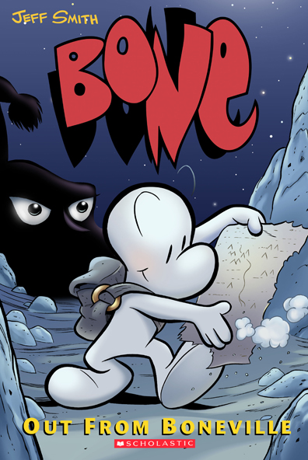
Book Five
A hero must save a valley from the forces of evil
The first book of the series involves three cousins
Their names are Fone, Phoney and Smiley

Slide 7
Book 6
There are now more than a dozen books in this survival series
The author is Lauren Tarshis
Yes, it’s “I Survived”, but what did Danny survive in Book #4 in Hawaii?

Slide 8
Book 7
It all starts in a strange and dangerous house
There’s an underground world of demons
Two kids need the help of a strange creature called Miskit

Slide 9
Book 8
This guy is on a roll
This guy is in a class by himself
This guy is in the zone

Slide 10
Book 9
The Chamber of Secrets
The Philosopher’s Stone
Yes, it’s Harry Potter…but which book includes the Triwizard Tournament?

Slide 11
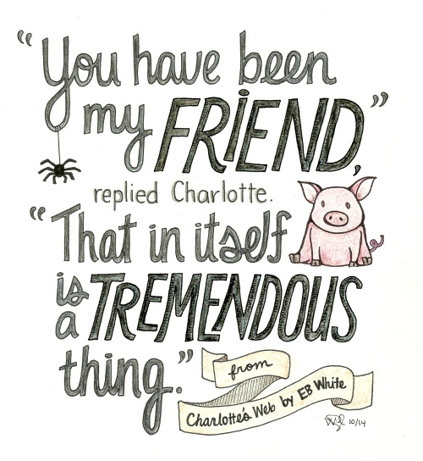
Book Ten
The story takes place on a farm
Quote: “Salutations is my fancy way of saying Hello…”
FYI – Some spiders recycle silk. They eat their old webs and start over with fresh stuff…

Slide 12
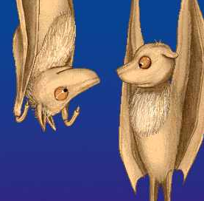
Bits of Books #1

Slide 13
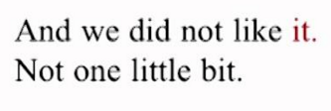
Bits of Books #2

Slide 14
Bits of Books #3

Slide 15
Bits of Books #4

Slide 16
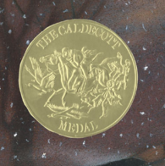
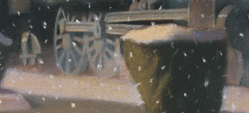
Bits of Books #5
The Caldecott Medal is the
highest honor for the artist of a picture book for children

Slide 17
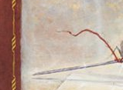
Bits of Books #6

Slide 18
Bits of Books #7

Slide 19
Bits of Books #8

Slide 20
Bits of Books #9

Slide 21
Bits of Books #10

